Slide 1
April 6, 2019

Slide 2
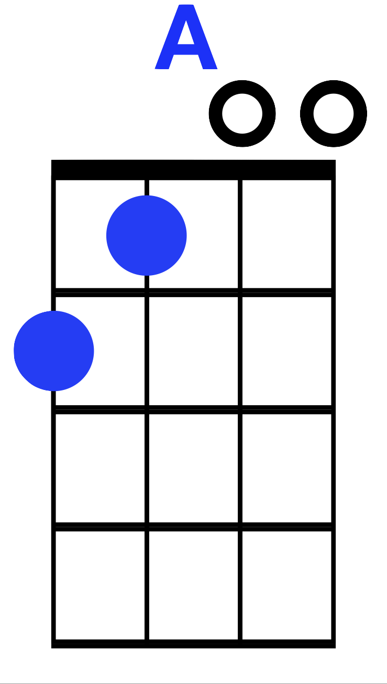
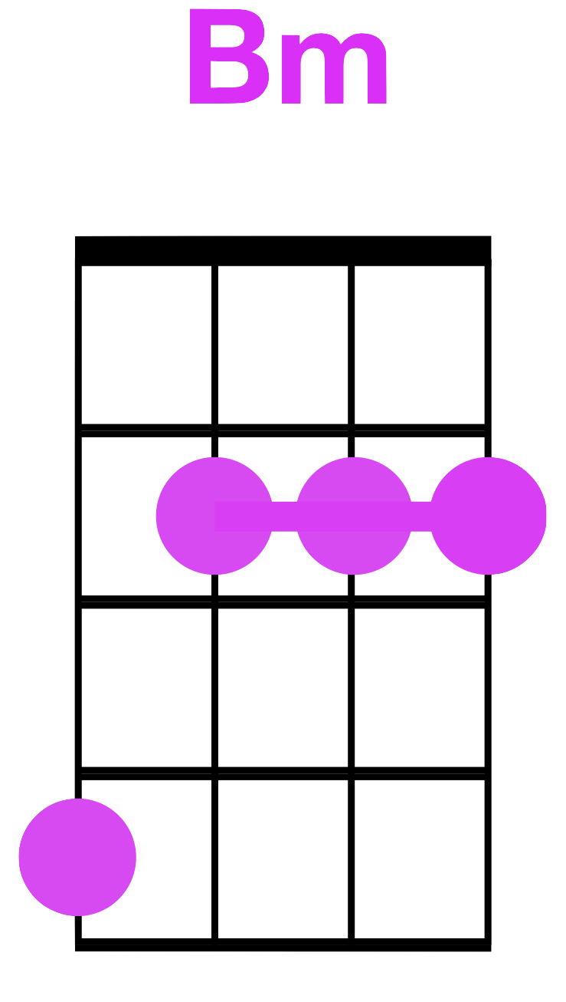
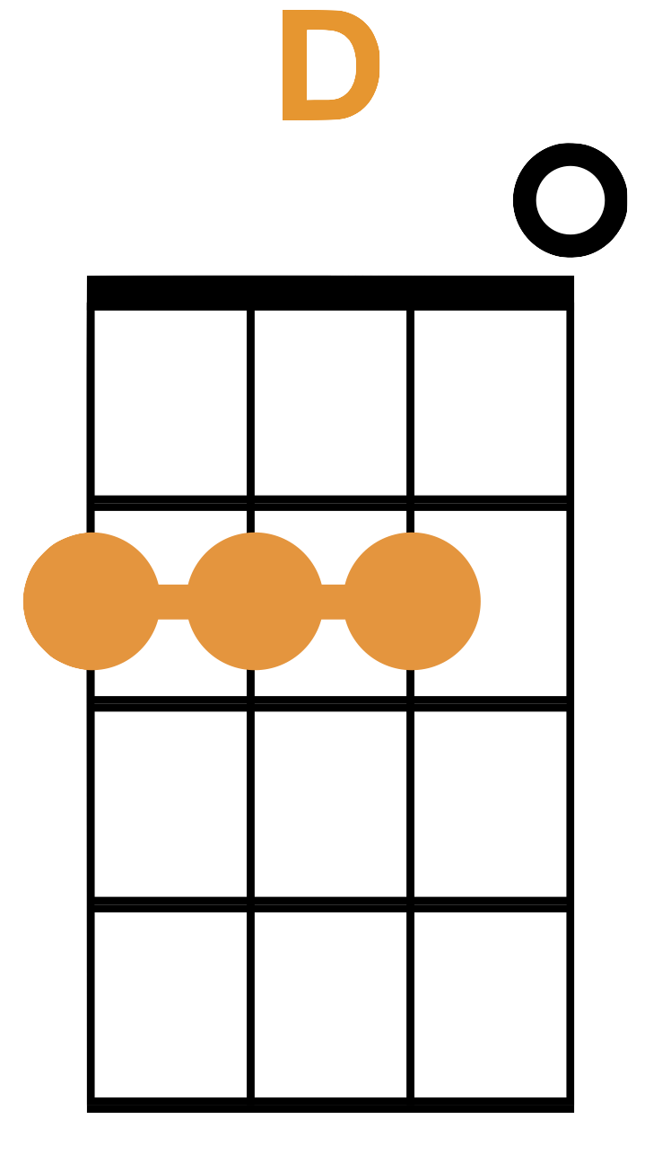
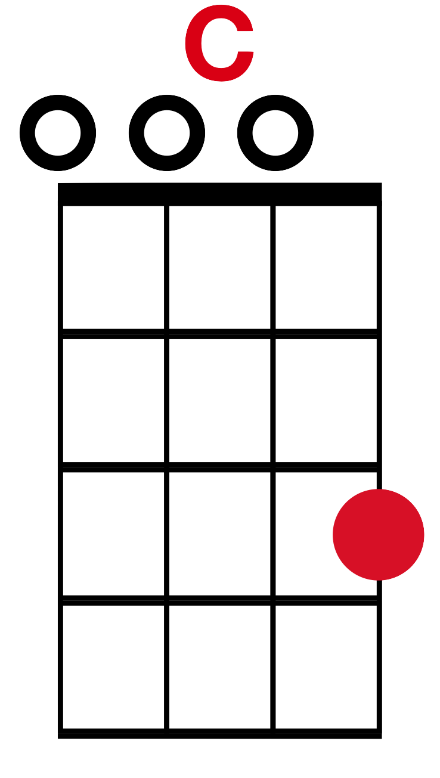
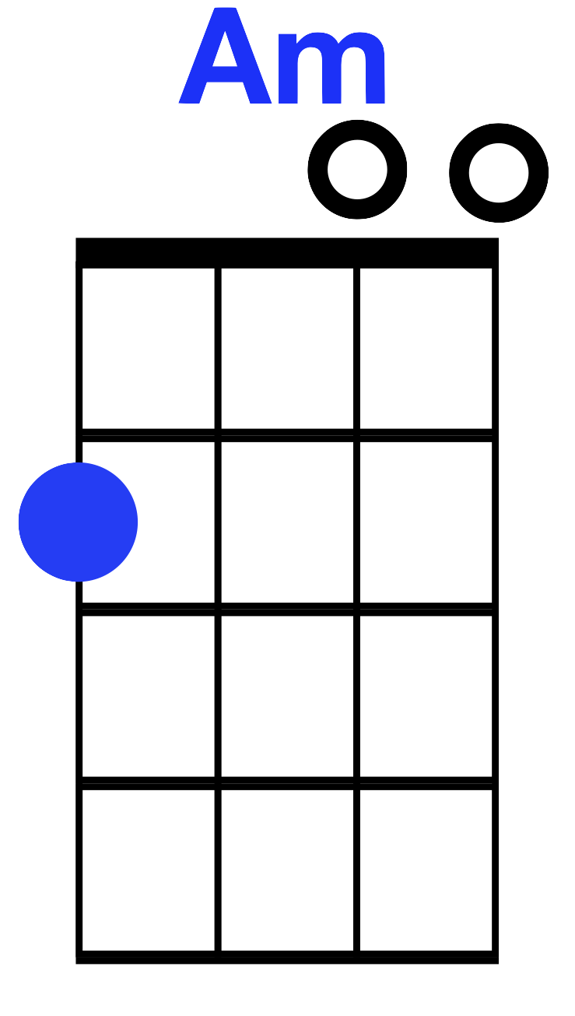
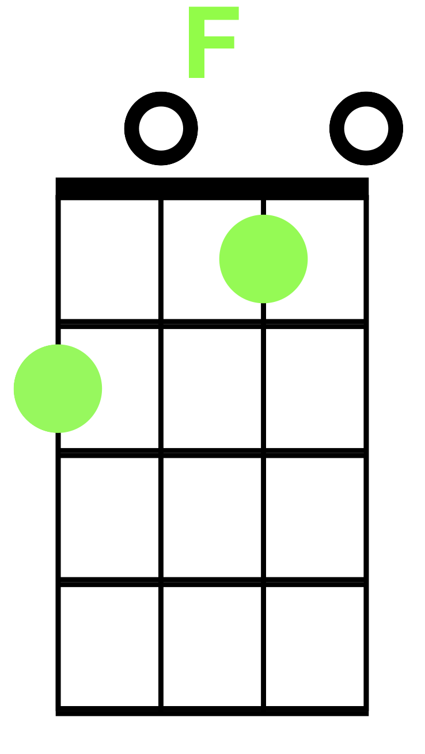
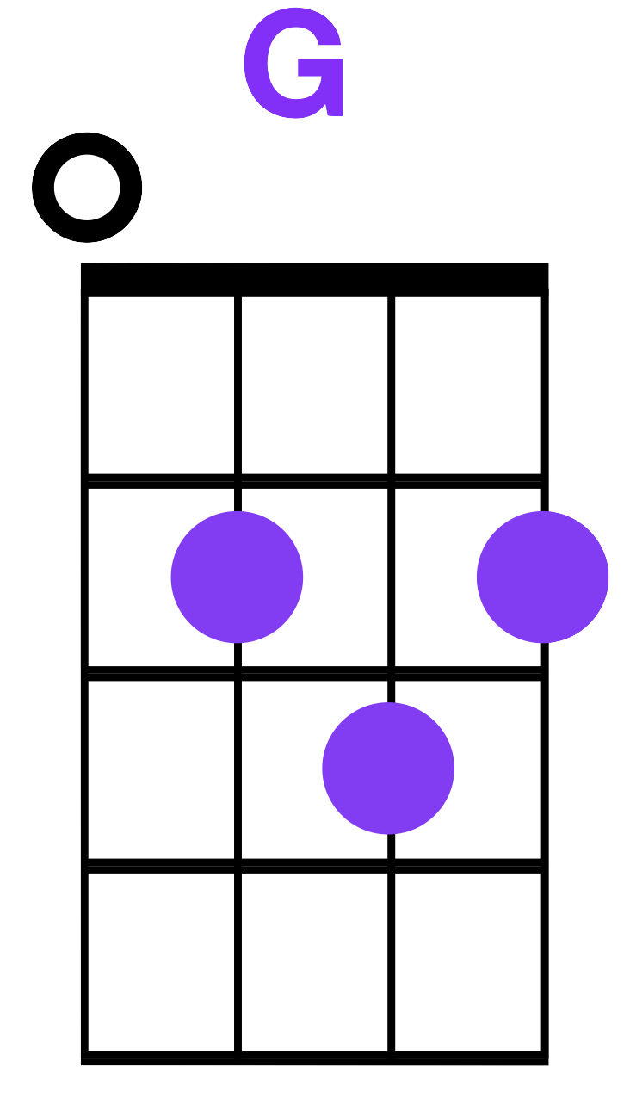
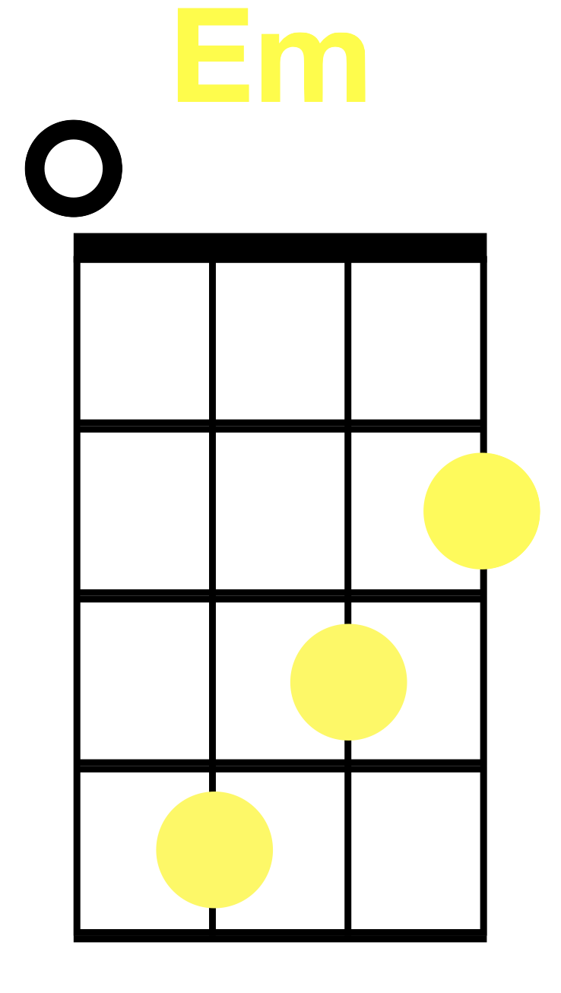
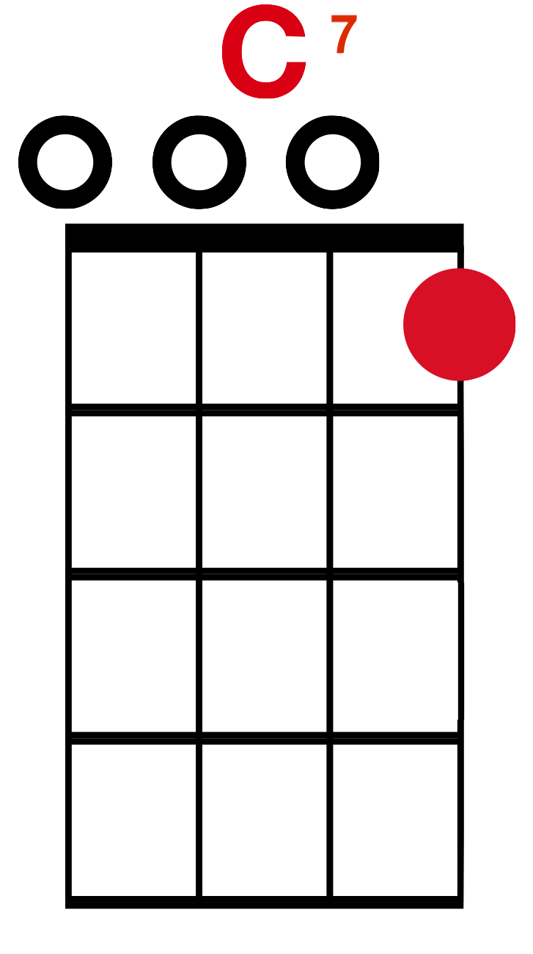
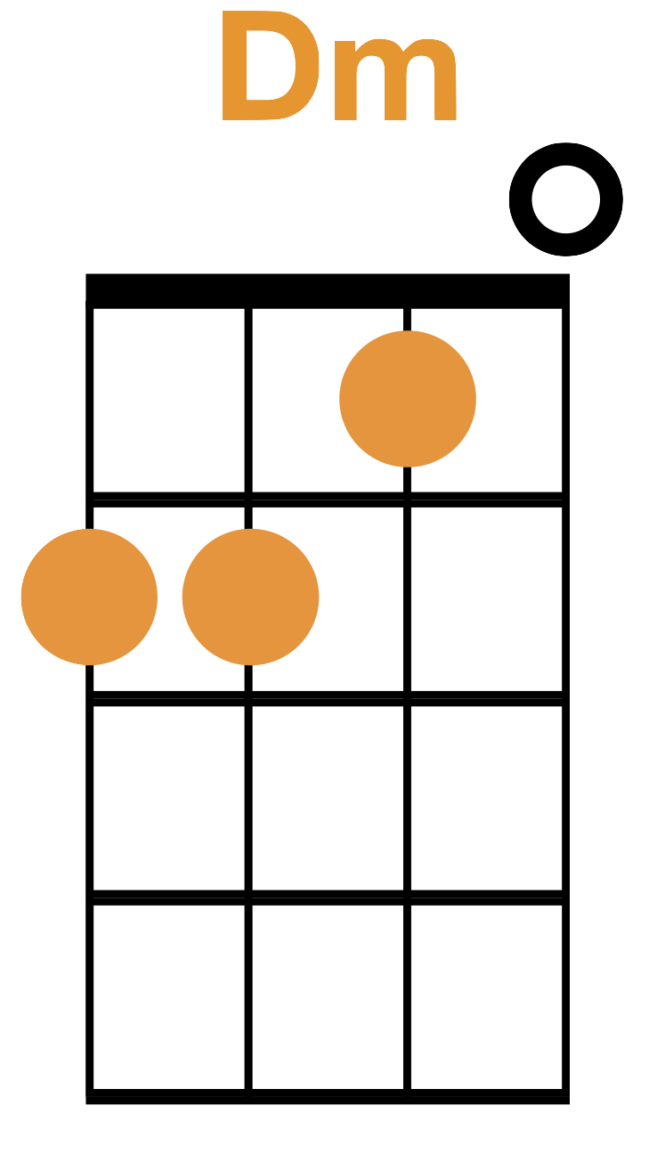
Chords!

Slide 3
Set List
ADAM
Born This Way A
You’re Welcome A
Viva La Vida (Emily or A)
ERICA
Low Rider E
Hallelujah E
Piano Man (Jacob or E)
SARAH
Don’t Stop Believing S
Are You Sleeping
Let It Be S
You Belong with Me (Hannah L or S)
REBECCA
Three Little Birds R
Somewhere Over the Rainbow R
Shenandoah (Lucy or R)
ADAM
Sweet Home Alabama (Tim or A)
Sweet Caroline A
Take Me Home Country Roads A
ERICA
Wagon Wheel E
Shake It Off E
Hey Soul Sister E
I’m Yours (Donny or E)
You Are My Sunshine (Donny or E)
SARAH
All Star S
Life is a Highway S
Count on Me (Hannah C or S)
Meant to Be (Jeremy or R or S)
REBECCA
Come Together R
Lion Sleeps Tonight R
Stitches R?

Slide 4
Wagon Wheel
Old Crow Medicine Show

Slide 5
Wagon Wheel
intro

Slide 6
Wagon Wheel
C G
Headed down south to the land of the pines
Am F
Thumbin’ my way into North Caroline
C Starin’ up the road...
G F Pray to God I see head-lights

Slide 7
Wagon Wheel
C G
Made it to the coast in seventeen hours
Am F
Picking me a bouquet of Dogwood flowers
C And I’m a hopin’ for Raleigh...
G F I can see my baby to-night

Slide 8
Wagon Wheel
C G
So rock me momma like a wagon wheel
Am F
Rock me momma, any way you feel
C G F Hey, - momma rock me

Slide 9
Wagon Wheel
C G
Rock me momma like the wind and the rain
Am F
Rock me momma like a south-bound train
C G F Hey, - momma rock me

Slide 10
Wagon Wheel
C G
Headed from the cold up in New England
Am F
I was born to be a fiddler in an old-time string band
C G My baby plays the guitar -
F I pick a banjo now

Slide 11
Wagon Wheel
C G
Oh, the North country winters keep a gettin’ me now
Am F
Lost my money playin’ poker so I had to up and leave
C But I ain’t turnin’ back
G F To livin’ that old life no more

Slide 12
Wagon Wheel
C G
So rock me momma like a wagon wheel
Am F
Rock me momma, any way you feel
C G F Hey, - momma rock me

Slide 13
Wagon Wheel
C G
Rock me momma like the wind and the rain
Am F
Rock me momma like a south-bound train
C G F Hey, - momma rock me

Slide 14
Wagon Wheel
C G
Walkin’ to the south out of Roanoke
Am F
I caught a trucker out in Philly, had a nice long toke
C G But he’s a headed west to the Cumberland Gap
F to Johnson city, Tennessee

Slide 15
Wagon Wheel
C G
And I gotta get a move on before before the sun
Am F
I hear my baby callin’ my name and I know that she’s the only one
C G F And if I die in Raleigh, at least I will die free.

Slide 16
Wagon Wheel
C G
So rock me momma like a wagon wheel
Am F
Rock me momma, any way you feel
C G F Hey, - momma rock me

Slide 17
Wagon Wheel
C G
Rock me momma like the wind and the rain
Am F
Rock me momma like a south-bound train
C G F Hey, - momma rock me.

Slide 18
Shake It Off
Taylor Swift

Slide 19
Shake It Off
intro

Slide 20
Shake It Off
Am
I stay out too late
C
Got nothing in my brain
G
That’s what people say, mmm (2x)

Slide 21
Shake It Off
Am
I go on too many dates
C
But I can’t make ‘em stay
G
That’s what people say, mmm (2x)

Slide 22
Shake It Off
Am
But I keep cruisin’
C
Can’t stop, won’t stop movin’
G
It’s like I got this music in my mind,
sayin’ it’s gonna be alright

Slide 23
Shake It Off
Am
Cause the players gonna play, play, play, play, play
C
And the haters gonna hate, hate, hate, hate, hate baby
G
I’m just gonna shake, shake, shake, shake, shake
Shake it off, I shake it off

Slide 24
Shake It Off
Am
Heart breakers gonna break, break, break, break, break
C
And the fakers gonna fake, fake, fake, fake, fake baby
G
I’m just gonna shake, shake, shake, shake, shake
Shake it off, I shake it off

Slide 25
Shake It Off
Am
I never miss a beat
C
I’m lightning on my feet
G
That’s what they don’t see, mmm (2x)

Slide 26
Shake It Off
Am
I’m dancing on my own
C
I make the moves up as I go
G
That’s what they don’t know, mmm (2x)

Slide 27
Shake It Off
Am
But I keep cruisin’
C
Can’t stop, won’t stop movin’
G
It’s like I got this music in my mind,
sayin’ it’s gonna be alright

Slide 28
Shake It Off
Am
Cause the players gonna play, play, play, play, play
C
And the haters gonna hate, hate, hate, hate, hate baby
G
I’m just gonna shake, shake, shake, shake, shake
Shake it off, I shake it off

Slide 29
Shake It Off
Am
Heart breakers gonna break, break, break, break, break
C
And the fakers gonna fake, fake, fake, fake, fake baby
G
I’m just gonna shake, shake, shake, shake, shake
Shake it off, I shake it off

Slide 30
Shake It Off
Am
Shake it off, shake it off, I-I-I
C
I shake it off, shake it off, I-I-I
G
I shake it off, shake it off, I-I-I
Shake it off, shake it off

Slide 31
Hey Soul Sister
Train

Slide 32
Hey Soul Sister
intro

Slide 33
Hey Soul Sister
C G
He-ey,
Am He-ey,
F He-ey,

Slide 34
Hey Soul Sister
C
Your lipstick stains
G Am F
On the front lobe of my left side brains
C I knew I wouldn’t forget you
G Am F And so I went and let you blow my mind

Slide 35
Hey Soul Sister
C
Your sweet moonbeam
G Am F
The smell of you in every single dream I dream
C I knew when we collided
G Am F You’re the one I have decided who’s one of my kind

Slide 36
Hey Soul Sister
C
Hey soul sister
G Am
Ain’t that mister mister on the radio, stereo
F The way you move ain’t fair you know

Slide 37
Hey Soul Sister
C
Hey soul sister
G Am F C
I don’t wanna miss a single thing, you do, tonight

Slide 38
Hey Soul Sister
C G
He-ey,
Am He-ey,
F He-ey,

Slide 39
Hey Soul Sister
C G
Just in time
Am F
I’m so glad you have a one track mind like me
C You gave my life direction
G F G A game show love connection you can’t deny-y-y

Slide 40
Hey Soul Sister
C G
I’m so obsessed
Am F
My heart is bound to beat right out my untrimmed chest
C I believe in you

Slide 41
Hey Soul Sister
G
Like a virgin you’re Madonna and I’m always gonna
Am F
wanna blow your mind

Slide 42
Hey Soul Sister
C
Hey soul sister
G Am
Ain’t that mister mister on the radio, stereo
F The way you move ain’t fair you know

Slide 43
Hey Soul Sister
C
Hey soul sister
G Am F C
I don’t wanna miss a single thing, you do, tonight

Slide 44
Hey Soul Sister
C
The way you can cut a rug
G
Watching you’s the only drug I need
Am
You’re so gangster I’m so thug
F
You’re the only one I’m dreaming of you see

Slide 45
Hey Soul Sister
C
I can be myself now finally
G
In fact there’s nothing I can’t be
Am F G
I want the world to see you be with me

Slide 46
Hey Soul Sister
C
Hey soul sister
G Am
Ain’t that mister mister on the radio, stereo
F The way you move ain’t fair you know

Slide 47
Hey Soul Sister
C
Hey soul sister
G Am F C
I don’t wanna miss a single thing, you do, tonight
C
Hey soul sister
G Am F C
I don’t wanna miss a single thing, you do, tonight

Slide 48
Hey Soul Sister
C G
He-ey,
Am He-ey,
F He-ey,
C
Tonight

Slide 49
I’m Yours
Jason Mraz

Slide 50
I’m Yours
intro

Slide 51
I’m Yours
C
Well, you done done me and you bet that I felt it
G
I tried to be chill but you’re so hot that I melted
Am I fell right through the cracks,
F and I’m trying to get back

Slide 52
I’m Yours
C
Before the cool done run out, I’ll be givin’ it my bestest
G
And nothin’s gonna stop me but divine intervention
Am I reckon it’s again my turn
F to win some or learn some

Slide 53
I’m Yours
C G But I won’t hesi-tate no more, Am F No more, it cannot wait I’m yours

Slide 54
I’m Yours
Instrumental Break

Slide 55
I’m Yours
C G
Well, open up your mind and see like me
Am
Open up your plans and then you’re free.
Look into your heart and you’ll find
F love, love, love, love.

Slide 56
I’m Yours
C
Listen to the music of the moment, people, dance
G
and sing.
Am We’re just one big family.
F and it’s our God-forsaken right to be loved, loved, loved, loved.
G
Loved….

Slide 57
I’m Yours
C G So I won’t hesi-tate no more, Am F No more, it cannot wait I’m sure

Slide 58
I’m Yours
C G There’s no need to compli-cate, Am Our time is short,
F
This is our fate. I’m yours

Slide 59
I’m Yours
C G Doo doo doo doo-doo, doo doo doo doo-doo. Am - Don’t ya want to come on,
G F
Scootch on over closer dear,
G
I’ll whisper in your ear...

Slide 60
I’m Yours
C
I’ve been spendin’ way too long checking my tongue in the mirror,
G
And bendin’ over backwards just to try to see it clearer.
Am But my breath fogged up the glass,
F So I drew a new face and I laughed

Slide 61
I’m Yours
C
I guess what I’ve been sayin’ is there ain’t no better reason
G
To rid yourself of vanities and just go with the seasons.
Am It’s what we aim to do,
F Our name is our virtue.

Slide 62
I’m Yours
C G But I won’t hesi-tate no more, Am F No more, it cannot wait I’m yours

Slide 63
I’m Yours
C G There’s no need to compli-cate, Am Our time is short,
F
This is our fate. I’m sure

Slide 64
I’m Yours
Instrumental Break

Slide 65
I’m Yours
C G
Well, open up your mind and see like me
Am
Open up your plans and then you’re free.
Look into your heart and you’ll find
F love, love, love, love.

Slide 66
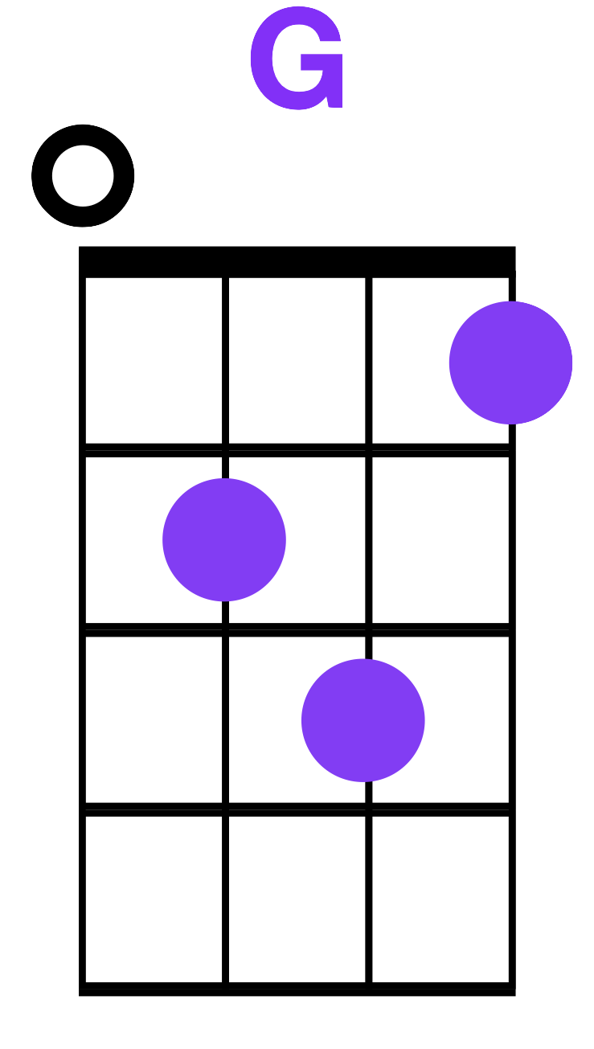
I’m Yours
C
Listen to the music of the moment, people, dance
G
and sing.
Am We’re just one big family.
F and it’s our God-forsaken right to be loved, loved, loved, loved.
G
Loved….

Slide 67
I’m Yours
C So please don’t, please don’t, please don’t
G
There’s no need to complicate,
Am Cause our time is short.
F
This oh this oh this is our fate.
G
I’m yours…….

Slide 68
You are my Sunshine
-Jimmie Davis

Slide 69
You are my Sunshine
C C7 You are my sunshine, my only sunshine F C C7 You make me happy, When skies are gray

Slide 70
You are my Sunshine
F C
You’ll never know dear, How much I love you, F G C Please don’t take, my sunshine away

Slide 71
You are my Sunshine
C C7 The other night dear, as I lay sleeping F C C7 I dreamed I held you, in my arms

Slide 72
You are my Sunshine
F C
But when I woke dear, I was mistaken, F G C And I hung, my head, and I cried

Slide 73
You are my Sunshine
C C7 You are my sunshine, my only sunshine F C C7 You make me happy, When skies are gray

Slide 74
You are my Sunshine
F C
You’ll never know dear, How much I love you, F G C Please don’t take, my sunshine away

Slide 75
All Star
Smash Mouth

Slide 76
All Star
intro

Slide 77
All Star
C G
Somebody once told me
Dm F
The world is gonna roll me
C G
I ain’t the sharpest tool
Dm F
In the shed

Slide 78
All Star
C G
She was looking kinda dumb
Dm F
With her finger and her thumb
C G
In the shape of an ”L”
Dm F
On her forehead

Slide 79
All Star
C G
Well the years start coming and they don’t stop coming
Dm F
Back to the rules and I hit the ground running
C G
Didn’t make sense not to live for fun
Dm F
Your brain gets smart but your head gets dumb

Slide 80
All Star
C G
So much to do so much to see
Dm F
So what’s wrong with taking the back streets
C G
You’ll never know if you don’t go
Dm F
You’ll never shine if you don’t glow

Slide 81
All Star
C G
Hey now you’re an All Star
Dm F
Get your game on, go play
C G
Hey now you’re a rock star
Dm F
Get the show on, get paid

Slide 82
All Star
C G Dm
And all that glitters is gold
F C G Dm
Only shooting stars break the mold

Slide 83
All Star
C G
It’s a cool place and they say it gets colder
Dm F
You’re bundled up now but wait ‘til you get older
C G
But the media men beg to differ
Dm F
Judging by the hole in the satellite picture

Slide 84
All Star
C G
The ice we skate is getting pretty thin
Dm F
The water’s getting warm so you might as well swim
C G
My world’s on fire how about yours
Dm F
That’s the way I like it and I never get bored

Slide 85
All Star
C G
Hey now you’re an All Star
Dm F
Get your game on, go play
C G
Hey now you’re an rock star
Dm F
Get the show on, get paid

Slide 86
All Star
C G Dm
And all that glitters is gold
F C G Dm
Only shooting stars break the mold

Slide 87
All Star
C G
Somebody once asked,
Dm F
Could you spare some change for gas
C G
I need to get myself away
Dm F
From this place

Slide 88
All Star
C G
I said yep what a concept
Dm F
I could use a little fuel myself
C G Dm F
And we could all use a little change

Slide 89
All Star
C G
Well the years start coming and they don’t stop coming
Dm F
Fed to the rules and I hit the ground running
C G
Didn’t make sense not to live for fun
Dm F
Your brain gets smart but your head gets dumb

Slide 90
All Star
C G
So much to do so much to see
Dm F
So what’s wrong with taking the back streets
C G
You’ll never know if you don’t go
Dm F
You’ll never shine if you don’t glow

Slide 91
All Star
C G
Hey now you’re an All Star
Dm F
Get your game on, go play
C G
Hey now you’re an rock star
Dm F
Get the show on, get paid

Slide 92
All Star
C G Dm
And all that glitters is gold
F C G Dm
Only shooting stars break the mold

Slide 93
Life is A Highway
Tom Cochrane / Rascal Flatts

Slide 94
Life is A Highway
intro

Slide 95
Life is A Highway
F
Life’s like a road that you travel on
C
When there’s one day here and the next day gone
G
Sometimes you bend and sometimes you stand,
Sometimes you turn your back to the wind

Slide 96
Life is A Highway
F
There’s a world outside every darkened door
C
Where blues won’t haunt you anymore
G
Where the brave are free and lovers soar
Come ride with me to the distant shore

Slide 97
Life is A Highway
Am
We won’t hesitate
G
Break down the garden's gate
F Dm
There’s not much time left today

Slide 98
Life is A Highway
Am F
Life is a highway,
C G
I wanna ride it all night long
Am F
If you’re going my way,
C G G
I wanna drive it all night long

Slide 99
Life is A Highway
F
Through all these cities and all these towns
C
It’s in my blood and it’s all around
G
I love you now like I loved you then
This is the road and these are the hands

Slide 100
Life is A Highway
F
From Mozambique to these those Memphis nights
C
The Kyber Pass to Vancouver’s light
G
Knock me down back up again
You’re in my blood, I’m not a lonely man

Slide 101
Life is A Highway
Am
There’s no load I can’t hold
G
Road so rough this I know
F
I’ll be there when the light comes in
Dm
Just tell’em we’re survivors

Slide 102
Life is A Highway
Am F
Life is a highway,
C G
I wanna ride it all night long
Am F
If you’re going my way,
C G G
I wanna drive it all night long

Slide 103
Life is A Highway
Dm F Am G G
There was a distance between you and I
Dm F
A misunderstanding once,
Am G G
But now we look in the eye

Slide 104
Life is A Highway
Am
There’s no load I can’t hold
G
Road so rough this I know
F
I’ll be there when the light comes in
Dm
Just tell’em we’re survivors

Slide 105
Life is A Highway
Home
Am F
Life is a highway,
C G
I wanna ride it all night long
Am F
If you’re going my way,
C G C
I wanna drive it all night long

Slide 106
Count on Me
Bruno Mars

Slide 107
Count on Me
intro

Slide 108
Count On Me
C
If you ever find yourself stuck
Em
In the middle of the sea
Am
I’ll sail the world
F
To find you

Slide 109
Count On Me
C
If you ever find yourself lost
Em
In the dark and you can’t see
Am
I’ll be the light
F
To guide you

Slide 110
Count On Me
Dm
Find out what we’re made of
F
When we are called to
G
Help our friends in need

Slide 111
Count On Me
C
You can count on me like
Em Am
One, two, three, I’ll be there
F
Cuz I know when I need it

Slide 112
Count On Me
C
I can count on you like
Em Am
Four, three, two, you’ll be there
F
Cuz that’s what friends are
S’posed to do oh yeah

Slide 113
Count On Me
C
Oooh
Em F
Oooh

Slide 114
Count On Me
C
If you’re tossin and you’re turning
Em
And you just can’t fall asleep
Am
I’ll sing a song
F
Beside you

Slide 115
Count On Me
C
And if you ever forget just how
Em
Much you really mean to me
Am
Everyday I will
F
Remind you

Slide 116
Count On Me
Dm
Find out what we’re made of
F
When we are called to
G
Help our friends in need

Slide 117
Count On Me
C
You can count on me like
Em Am
One, two, three, I’ll be there
F
Cuz I know when I need it

Slide 118
Count On Me
C
I can count on you like
Em Am
Four, three, two, you’ll be there
F
Cuz that’s what friends are
S’posed to do oh yeah

Slide 119
Count On Me
C
Oooh
Em F
Oooh

Slide 120
Count On Me
Dm Em
You’ll always have my shoulder
Am
When you cry
Dm Em
I’ll never let go, never say
Am
Goodbye, you know-

Slide 121
Count On Me
C
You can count on me like
Em Am
One, two, three, I’ll be there
F
Cuz I know when I need it

Slide 122
Count On Me
C
I can count on you like
Em Am
Four, three, two, you’ll be there
F
Cuz that’s what friends are
S’posed to do oh yeah

Slide 123
Count On Me
C
Oooh
Em F
Oooh

Slide 124
Meant to Be
By Bebe Rexha/Florida Georgia Line

Slide 125
Meant to Be
G Am Em
Baby, lay on back and relax
C G
Kick your pretty feet up on my dash
G Am Em
No need to go nowhere fast,
C G
Let’s enjoy right here where we at

Slide 126
Meant to Be
G Am Em
Who knows where this road is supposed to lead
C G
We got nothing but time
G Am Em
As long as you’re right here next to me,
C G
Everything’s gonna be alright

Slide 127
Meant to Be
G Am Em
If it’s meant to be, it’ll be, it’ll be
C G
Baby just let it be
G Am Em
If it’s meant to be, it’ll be, it’ll be
C G
Baby just let it be

Slide 128
Meant to Be
G Am
So won’t you ride with me, ride with me?
Em C
See where this thing goes
G Am Em
If it’s meant to be, it’ll be, it’ll be
C G
Baby if it’s meant to be

Slide 129
Meant to Be
G Am Em
I don’t mean to be so uptight
C G
But my heart’s been hurt a couple times
G Am Em
By a couple guys that didn’t treat me right
C G
I ain’t gon’ lie, ain’t gonna lie

Slide 130
Meant to Be
G Am
‘Cause I’m tired of the fake love
Em
show me what you’re made of
C G
Boy, make me believe
G Am Em
But hold up, girl, don’t you know you’re beautiful?
C G
And it’s easy to see

Slide 131
Meant to Be
G Am Em
If it’s meant to be, it’ll be, it’ll be
C G
Baby just let it be
G Am Em
If it’s meant to be, it’ll be, it’ll be
C G
Baby just let it be

Slide 132
Meant to Be
G Am
So won’t you ride with me, ride with me?
Em C
See where this thing goes
G Am Em
If it’s meant to be, it’ll be, it’ll be
C G
Baby if it’s meant to be

Slide 133
Meant to Be
G Am Em
So c’mon ride with me, ride with me?
C G
See where this thing goes
G Am Em
So c’mon ride with me, ride with me?
C G
Baby, if it’s meant to be

Slide 134
Meant to Be
G
Maybe we do
Am Em
Maybe we don’t
C
Maybe we will
G
Maybe we won’t

Slide 135
Meant to Be
(N.C.)
If it’s meant to be, it’ll be, it’ll be
Baby just let it be
If it’s meant to be it’ll be, it’ll be
Baby just let it be

Slide 136
Meant to Be
G Am
So won’t you ride with me, ride with me?
Em C
See where this thing goes
G Am Em
If it’s meant to be, it’ll be, it’ll be
C G
Baby if it’s meant to be

Slide 137
Meant to Be
G Am Em
If it’s meant to be, it’ll be, it’ll be
C G
Baby if it’s meant to be
G Am Em
If it’s meant to be, it’ll be, it’ll be
C G
Baby if it’s meant to be

Slide 138
Come Together
The Beatles

Slide 139
Come Together
intro

Slide 140
Come Together
Dm
…. Here come old flat top, he come
Dm
…. Groovin’ up slowly, he got
Dm
…. Joojoo eyeball, he one
Dm
…. Holy roller, he got

Slide 141
Come Together
A
…. Hair down, to his knee...
G
Got to be a joker, he just do what he please.

Slide 142
Come Together

Slide 143
Come Together
Dm
…. He wear no shoe shine, he got
Dm
…. Toe jam football, he got
Dm
…. Monkey finger, he shoot
Dm
…. Coca cola, he say

Slide 144
Come Together
A
…. I know you, and you know me
G
one thing I can tell you is you got to be free.

Slide 145
Come Together
Bm
Come together
G A
Right now... ….
Dm
Over me

Slide 146
Come Together

Slide 147
Come Together
Dm
…. He bag production, he got
Dm
…. Walrus gumboot, he got
Dm
…. O-no sideboard, he one
Dm
…. Spinal cracker, he got

Slide 148
Come Together
A
…. Feet down, below his knee
G
hold you in his armchair, you can feel his disease.

Slide 149
Come Together
Bm
Come together
G A
Right now... ….
Dm
Over me

Slide 150
Come Together

Slide 151
Come Together
Dm
…. He roller coaster, he got
Dm
…. Early warning, he got
Dm
…. Muddy water, he one
Dm
…. Mojo filter, he say

Slide 152
Come Together
A
…. One and one and one is three.
G
Got to be good lookin’ cause he’s so hard to see.

Slide 153
Come Together
Bm
Come together
G A
Right now... ….
Dm
Over me

Slide 154
Come Together
Home
Bm
Come together
G A
Right now... ….
Dm
Over me

Slide 155
The Lion Sleeps Tonight

Slide 156
The Lion Sleeps Tonight - intro
C F Wimoweh wimoweh, Wimoweh wimoweh, C G Wimoweh wimoweh, Wimoweh wimoweh, (x2)
C F C G Oo ----- oo ----- wi ---- um -- um -- away C F C G Oo ----- oo ----- wi ---- um -- um -- away

Slide 157
The Lion Sleeps Tonight
C F In the jungle the mighty jungle C G The lion sleeps to-night,
C F In the jungle the quiet jungle C G The lion sleeps to-night.

Slide 158
The Lion Sleeps Tonight - intro
C F Wimoweh wimoweh, Wimoweh wimoweh, C G Wimoweh wimoweh, Wimoweh wimoweh, (x2)
C F C G Oo ----- oo ----- wi ---- um -- um -- away C F C G Oo ----- oo ----- wi ---- um -- um -- away

Slide 159
The Lion Sleeps Tonight
C F Near the village the peaceful village C G The lion sleeps to-night,
C F Near the jungle the peaceful jungle C G The lion sleeps to-night.

Slide 160
The Lion Sleeps Tonight - intro
C F Wimoweh wimoweh, Wimoweh wimoweh, C G Wimoweh wimoweh, Wimoweh wimoweh, (x2)
C F C G Oo ----- oo ----- wi ---- um -- um -- away C F C G Oo ----- oo ----- wi ---- um -- um -- away

Slide 161
The Lion Sleeps Tonight
C F Hush my darling, don’t fear my darling C G The lion sleeps to-night,
C F Hush my darling, don’t fear my darling C G The lion sleeps to-night.

Slide 162
The Lion Sleeps Tonight - intro
Home
C F Wimoweh wimoweh, Wimoweh wimoweh, C G Wimoweh wimoweh, Wimoweh wimoweh, (x2)
C F C G Oo ----- oo ----- wi ---- um -- um -- away C F C G Oo ----- oo ----- wi ---- um -- um -- away

Slide 163
Stitches
By: Shawn Mendes

Slide 164
Stitches
Am G C (F)
I thought that I’ve been hurt before
Am G C (F)
But no one’s ever left me quite as sore

Slide 165
Stitches
Am G C (F)
Your words cut deeper than a knife
Am G C (F)
Now I need someone to breathe me back to life

Slide 166
Stitches
Am G
Got a feeling that I’m going under
C F
But I know that I’ll make it out alive.

Slide 167
Stitches
Am G
If I quit calling you my lover
C (F)
Move on

Slide 168
Stitches
(F) Am
You watch me bleed until I can’t breathe
G C (F)
I’m shaking, falling onto my knees

Slide 169
Stitches
(F) Am G
And now that I’m without your kisses
C F
I’ll be needing stitches

Slide 170
Stitches
Am
I’m tripping over myself,
G C (F)
I’m aching begging you to come help

Slide 171
Stitches
(F) Am G
And now that I’m without your kisses
C F
I’ll be needing stitches

Slide 172
Stitches
Am G C (F)
Just like a moth drawn to a flame
Am G C
Oh, you lured me in, I couldn’t sense the pain
(F)

Slide 173
Stitches
Am G C (F)
Your bitter heart cold to the touch
Am G
Now I’m gonna reap what I sow
C (F)
I’m left seeing red on my own

Slide 174
Stitches
Am G
Got a feeling that I’m going under
C F
But I know that I’ll make it out alive.

Slide 175
Stitches
Am G
If I quit calling you my lover
C (F)
Move on

Slide 176
Stitches
(F) Am
You watch me bleed until I can’t breathe
G C (F)
I’m shaking, falling onto my knees

Slide 177
Stitches
(F) Am G
And now that I’m without your kisses
C F
I’ll be needing stitches

Slide 178
Stitches
Am
I’m tripping over myself,
G C (F)
I’m aching begging you to come help

Slide 179
Stitches
(F) Am G
And now that I’m without your kisses
C F
I’ll be needing stitches

Slide 180
Stitches
Interlude (2x): Am G C F

Slide 181
Stitches
Am
Needle and the thread,
G
Gotta get you out of my head
C
Needle and the thread,
F
Gotta wind up dead
(x3)

Slide 182
Stitches
Am
Needle and the thread,
C
Gotta get you out of my head,
G
get you out of my head
(Break)

Slide 183
Stitches
Am
You watch me bleed until I can’t breathe
G C (F)
I’m shaking, falling onto my knees

Slide 184
Stitches
(F) Am G
And now that I’m without your kisses
C F
I’ll be needing stitches

Slide 185
Stitches
Am
I’m tripping over myself,
G C (F)
I’m aching begging you to come help

Slide 186
Stitches
(F) Am G
And now that I’m without your kisses
C F
I’ll be needing stitches
(X3)...............then

Slide 187
Born This Way
Lady GaGa

Slide 188
Born This Way
intro

Slide 189
Born This Way
G F
My mama told me when I was young
C G
We were all born superstars
G F
She rolled my hair and put my lipstick on
C G
In the glass of her boudoir

Slide 190
Born This Way
G F
“There’s nothing wrong with lovin’ who you are”
C G
She said, “‘Cause he made you perfect, babe
G F
“So hold your head up, girl and you you’ll go far,
C G
Listen to me when I say”

Slide 191
Born This Way
G
I’m beautiful in my way,
F
‘Cause God makes no mistakes
C
I’m on the right track, baby
G
I was born this way

Slide 192
Born This Way
G
Don’t hide yourself in regret,
F
Just love yourself and you’re set
C
I’m on the right track, baby
G
I was born this way

Slide 193
Born This Way
G
Ooo, there ain’t no other way
F
Baby, I was born this way
C
Baby, I was born this way

Slide 194
Born This Way
G
Ooo, there ain’t no other way
F
Baby, I was born this way
C
I’m on the right track, baby
G
I was born this way

Slide 195
Born This Way
G F
Don’t be a drag, just be a queen
G F
Don’t be a drag, just be a queen
G F
Don’t be a drag, just be a queen
G
Don’t be!

Slide 196
Born This Way
G F
Give yourself prudence and love your friends
C G
Subway kid, rejoice your truth
G F
In the religion of the insecure
C G
I must be myself, respect my youth

Slide 197
Born This Way
G F
A different lover is not a sin
C G
Believe capital H-I-M
G F
I love my life, I love this record and
C G
Mi amore vole fe yah

Slide 198
Born This Way
G
I’m beautiful in my way,
F
‘Cause God makes no mistakes
C
I’m on the right track, baby
G
I was born this way

Slide 199
Born This Way
G
Don’t hid yourself in regret,
F
Just love yourself and you’re set
C
I’m on the right track, baby
G
I was born this way

Slide 200
Born This Way
G
Ooo, there ain’t no other way
F
Baby, I was born this way
C
Baby, I was born this way
G
Ooo, there ain’t no other way

Slide 201
Born This Way
F
Baby, I was born this way
C
I’m on the right track, baby
G
I was born this way

Slide 202
Born This Way
G F
Don’t be a drag, just be a queen
G F
Whether you’re broke or evergreen
G F
You’re black, white, beige, chola descent
G F
You’re lebanese, you’re orient

Slide 203
Born This Way
G F
Whether life’s disabilities
G F
Left you outcast, bullied or teased
G F
Rejoice and love yourself today
G
‘Cause baby, you were born this way

Slide 204
Born This Way
G
No matter gay, straight or bi
F
Lesbian, transgendered life
C
I’m on the right track, baby
G
I was born to survive

Slide 205
Born This Way
G
No matter black, white or beige
F
Chola or orient made
C
I’m on the right track, baby
G
I was born to be brave

Slide 206
Born This Way
G
I’m beautiful in my way,
F
‘Cause God makes no mistakes
C
I’m on the right track, baby
G
I was born this way

Slide 207
Born This Way
G
Don’t hide yourself in regret,
F
Just love yourself and you’re set
C
I’m on the right track, baby
G
I was born this way

Slide 208
Born This Way
G
Ooo, there ain’t no other way
F
Baby, I was born this way
C
Baby, I was born this way

Slide 209
Born This Way
G
Ooo, there ain’t no other way
F
Baby, I was born this way
C
I’m on the right track, baby
G
I was born this way

Slide 210
Born This Way
G
I was born this way, hey!
F
I was born this way, hey!
C
I’m on the right track, baby
G
I was born this way, hey!

Slide 211
Born This Way
Home
G
I was born this way, hey!
F
I was born this way, hey!
C
I’m on the right track, baby
G
I was born this way, hey!

Slide 212
You’re Welcome
Lin Manuel Miranda

Slide 213
You’re Welcome
intro

Slide 214
You’re Welcome
Am F C
What can I say except you’re welcome
G Am
For the tides, the sun, the sky
F C
Hey, it’s okay,it’s okay, you’re welcome
G Am
I’m just an ordinary demi-guy

Slide 215
You’re Welcome
F C
I see what’s happening yeah
G Am
You’re face to face with greatness, and it’s strange
F C
You don’t even know how you feel it’s adorable!
G Am
Well, it’s nice to see that humans never change

Slide 216
You’re Welcome
F C
Open your eyes, let’s begin
G Am
Yes, it’s really me, it’s Maui: breathe it in!
F C
I know it’s a lot: the hair, the bod!
G
When you’re staring at a demigod

Slide 217
You’re Welcome
Am F C
What can I say except you’re welcome
G Am
For the tides, the sun, the sky
F C
Hey, it’s okay,it’s okay, you’re welcome F
G Am
I’m just an ordinary demi-guy

Slide 218
You’re Welcome
F C
Hey! What has two thumbs and pulled up the sky
G
When you were waddling ye high
This guy!

Slide 219
You’re Welcome
Am F
When the nights got cold
C
Who stole you fire from down below
G
You’re looking at him, yo

Slide 220
You’re Welcome
Am F C
Oh, also I lasso’d the sun
You’re welcome!
G Am
To stretch your days and bring you fun

Slide 221
You’re Welcome
F C
Also I harnessed the breeze
You’re welcome!
G
To fill your sails and shake your trees

Slide 222
You’re Welcome
Am F C
So what can I say except you’re welcome
G Am
For the islands I pulled from the sea
F C
There’s no need to pray,it’s okay, you’re welcome!

Slide 223
You’re Welcome
G Am
I guess it’s just my way of being me
F C
You’re welcome, you’re welcome!
G
Well come to think of it

Slide 224
You’re Welcome
Am
Kid honestly I can go on and on
F
I can explain every natural phenomenon
C
The tide, the grass, the ground
G
Oh that was Maui just messing around

Slide 225
You’re Welcome
Am
I killed an eel, I buried its guts
F
Sprouted a tree now you’ve got coconuts
C
What’s the lesson? What is the takeaway?
G
Don’t mess with Maui when he’s on the breakaway

Slide 226
You’re Welcome
Am
And the tapestry here in my skin
F
Is a map of the victories I win
C
Look where I’ve been, I make everything happen
Am F
Look at that mean mini Maui just tippity tappin’

Slide 227
You’re Welcome
Am F C
Well anyway let me say you’re welcome
G Am
For the wonderful world you know
F C
Hey it’s okay,it’s okay, you’re welcome!
G Am
Well come to think of it, I gotta go!

Slide 228
You’re Welcome
F C
Hey it’s your day to say you’re welcome
G Am
‘Cause I’m gonna need that boat
F C
I’m sailing away,away, you’re welcome!
G Am
‘Cause Maui can do anything but float

Slide 229
You’re Welcome
Home
F C
You’re welcome, you’re welcome!
C
And thank you!

Slide 230
Viva La Vida
-Coldplay

Slide 231
Viva la Vida
Intro x2

Slide 232
Viva la Vida
F G
I used to rule the world
C Am
Seas would rise when I gave the word
F G Now in the morning I sleep alone
C Am Sweep the streets I used to own

Slide 233
Viva la Vida
F G
I used to roll the dice
C Am
Feel the fear in my enemy’s eyes
F G Listen as the crowd would sing
C Am Now the old king is dead, long live the king

Slide 234
Viva la Vida
F G
One minute I held the key
C Am
Next the walls were closed on me
F G And I discovered that my castle stands
C Am Upon pillars of salt and pillars of sand

Slide 235
Viva la Vida
F G
I hear Jerusalem bells a ringing
C Am
Roman Cavalry choirs a singing
F G Be my mirror my sword and shield
C Am My missionaries in a foreign field

Slide 236
Viva la Vida
F G
For some reason I can’t explain
C Am
Once you go there was never
F G Never an honest word
C Am That was when I ruled the world

Slide 237
Viva la Vida

Slide 238
Viva la Vida
F G
It was the wicked and wild wind
C Am
Blew down the doors to let me in
F G Shattered windows and the sound of drums
C Am People couldn’t believe what I’d become

Slide 239
Viva la Vida
F G
Revolutionaries wait
C Am
For my head on a silver plate
F G Just a puppet on a lonely string
C Am Oh who would ever want to be king

Slide 240
Viva la Vida
F G
I hear Jerusalem bells a ringing
C Am
Roman Cavalry choirs a singing
F G Be my mirror my sword and shield
C Am My missionaries in a foreign field

Slide 241
Viva la Vida
F G
For some reason I can’t explain
C Am
I know St. Peter won’t call my name
F G Never an honest word
C Am That was when I ruled the world

Slide 242
Low Rider
War

Slide 243
Low Rider
INTRO

Slide 244
Low Rider
intro
G G G
Do do do do do do do do do do do do
G G G
Do do do do do do do do do do do do

Slide 245
Low Rider
G G G
All my friends know the low rider
G G G
The low rider is a little higher
G G G
Low rider drives a little slower
G G G
Low rider he’s a real go’er

Slide 246
Low Rider
F F
Take a little trip, take a little trip
F G
Take a little trip with me
F F
Take a little trip, take a little trip
F G
Take a little trip and see

Slide 247
Low Rider
G G G
Do do do do do do do do do do do do
G G G
Do do do do do do do do do do do do

Slide 248
Low Rider
G G G
Low rider knows every street, yeah
G G G
The low rider he’s the one to meet, yeah
G G G
Low rider don’t use no gas now
G G G
Low rider don’t drive too fast

Slide 249
Low Rider
F F
Take a little trip, take a little trip
F G
Take a little trip with me
F F
Take a little trip, take a little trip
F G
Take a little trip and see

Slide 250
Low Rider
Home
G G G
Do do do do do do do do do do do do
G G G
Do do do do do do do do do do do do

Slide 251
Hallelujah
Leonard Cohen

Slide 252
Hallelujah
intro

Slide 253
Hallelujah
C Am
I’ve heard there was a secret chord
C Am
That David played and it pleased the Lord
F G C F
But you don’t really care for music do you?

Slide 254
Hallelujah
C F G
It goes like this, the fourth the fifth,
Am F
The minor fall, the major lift
G Em Am The baffled king composing Hallelujah

Slide 255
Hallelujah
F Am
Hallelujah, Hallelujah
F C G C
Hallelujah, Hallelujah

Slide 256
Hallelujah
C Am
Your faith was strong but you needed proof
C Am
You saw her bathing on the roof
F G C G
Her beauty in the moonlight overthrew you

Slide 257
Hallelujah
C F C
She tied you to a kitchen chair
Am F
She broke your throne and she cut your hair
G Em Am And from your lips she drew the Hallelujah

Slide 258
Hallelujah
F Am
Hallelujah, Hallelujah
F C G C
Hallelujah, Hallelujah

Slide 259
Hallelujah
C Am
Maybe I’ve been here before
C Am
I know this room, I’ve walked this floor
F G C G
I used to live alone before I knew you

Slide 260
Hallelujah
C F G
I’ve seen your flag on the marble arch
Am F
Love is not a victory march
G Em Am It’s a cold and it’s a broken the Hallelujah

Slide 261
Hallelujah
Home
F Am
Hallelujah, Hallelujah
F C G C
Hallelujah, Hallelujah

Slide 262
Piano Man
Billy Joel

Slide 263
Piano Man
Billy Joel

Slide 264
Piano Man
C G F C
It’s nine o’clock on a saturday
F C D G The regular crowd shuffles in
C G F C
There’s an old man sitting next to me
F G C
Sending love to his tonic and gin

Slide 265
Piano Man
C G F C
He says “son can you play me a memory?
F C D G
I’m not really sure how it goes
C G F C
But it’s sad and it’s sweet and I knew it complete
F G C
When I wore a younger man’s clothes”

Slide 266
Piano Man
Am
La La La
D
Di da da
Am
La La Di Di
D G F C G
Da Da Dum

Slide 267
Piano Man
C G F C
Sing us a song you’re the piano man
F C D G
Sing us a song tonight
C G F C
Well we’re all in the mood for a melody
F G C G
And you’ve got is feeling alright

Slide 268
Piano Man
C F C
Now John he is a friend of mine
F C D G
He gets me my drinks for free
C G
And he’s quick with a joke
F G C
But there’s some place that he’d rather be
G

Slide 269
Piano Man
C G F C
He says “Bill I believe this is killing me,
F C D G
As a smile ran away from his face,
C G F C
Well I’m sure I could be a movie star,
F G C
If I could get out of this place”

Slide 270
Piano Man
Am
La La La
D
Di da da
Am
La La Di Di
D G F C G
Da Da Dum

Slide 271
Piano Man
C G F C
Now Paul is a real estate novelist
F C D G
Who never had time for a wife
C G F
And he’s talking with Davy, who’s still
C
In the navy
F G C
And probably will be for life

Slide 272
Piano Man
C G F C
And the waitress is practicing politics
F C D G
As the businessman slowly goes home
C G F C
Yes they’re sharing a drink they call loneliness
F G C
But it’s better than drinking alone

Slide 273
Piano Man
C G F C
Sing us a song you’re the piano man
F C D G
Sing us a song tonight
C G F C
Well we’re all in the mood for a melody
F G C G
And you’ve got is feeling alright

Slide 274
Piano Man
C G F C
It’s a pretty good crowd for a saturday
F C D G
And the manager gives me a smile
F G
‘Cause he knows that it’s me they’ve been
F C
Coming to see,
F G C G
To forget about life for a while

Slide 275
Piano Man
C G F C
And the piano it sounds like a carnival!
F C D G
And the microphone smells like a beer
C G
And they sit at the bar and
F C
Put bread in my jar
F G C G
And say “man what are you doing here!”

Slide 276
Piano Man
Am
La La La
D
Di da da
Am
La La Di Di
D G F C G
Da Da Dum

Slide 277
Piano Man
C G F C
Sing us a song you’re the piano man
F C D G
Sing us a song tonight
C G F C
Well we’re all in the mood for a melody
F G C G
And you’ve got us feeling alright.

Slide 278
Don’t Stop Believin’
Journey

Slide 279
Don’t Stop Believin’
intro

Slide 280
Don’t Stop Believin’
C G
... just a small town girl
Am F
... Livin’ in a lonely world.
C G ... She took the midnight train
Em F Goin’ any-where……..

Slide 281
Don’t Stop Believin’
C G
... just a small town girl
Am F
... Livin’ in a lonely world.
C G ... She took the midnight train
Em F Goin’ any-where……..

Slide 282
Don’t Stop Believin’
C G
... just a city boy
Am F
... born and raised in south Detroit.
C G ... He took the midnight train
Em F Goin’ any-where……..

Slide 283
Don’t Stop Believin’
C G
... A singer in a smokey room,
Am F
... the smell of wine and cheap perfume.
C G ... For a smile they can share the night
Em F It goes on- and on and on and on.

Slide 284
Don’t Stop Believin’
F
Strangers waiting
C - up and down the boulevard, their
F C Shadows searchin’ in the night

Slide 285
Don’t Stop Believin’
F
Street light, people
C - living just to find emotion
F G G Hiding somewhere in the night...

Slide 286
Don’t Stop Believin’
C G
... workin’ hard to get my thrill.
Am F
... Everybody wants a thrill.
C G ... Paying anything to roll the dice
Em F Just one more time……..

Slide 287
Don’t Stop Believin’
C G
... some will win, some will lose.
Am F
... Some were born to sing the blues.
C G ... Oh, the movie never ends.
Em F It goes on- and on and on and on.

Slide 288
Don’t Stop Believin’
F
Strangers waiting
C - up and down the boulevard, their
F C Shadows searchin’ in the night

Slide 289
Don’t Stop Believin’
F
Street light
C - living just to find emotion
F G Hiding somewhere in the night...

Slide 290
Don’t Stop Believin’
C G
Don’t stop believin’
Am F
... Hold on to that feelin’
C G Street light people

Slide 291
Don’t Stop Believin’
Home
C G
Don’t stop believin’
Am F
... Hold on to that feelin’
C G Am F Street light people, oh oh oh oh oh
C
Don’t stop

Slide 292
Are You Sleeping?

Slide 293
Are You Sleeping
C C
Are you sleeping, are you sleeping?
C C
Brother John, brother John?
C C
Morning bells are ringing, morning bells are ringing
C C
Ding dang dong, ding dang dong

Slide 294
Are You Sleeping
C C
Frère Jacques, frère Jacques
C C
Dormez-vous, dormez-vous?
C C
Sonnez les matines, Sonnez les matines
C C
Ding dang dong, ding dang dong

Slide 295
Are You Sleeping
Home
C C
Are you sleeping, are you sleeping?
C C
Brother John, brother John?
C C
Morning bells are ringing, morning bells are ringing
C C
Ding dang dong, ding dang dong

Slide 296
Let it Be
The Beatles

Slide 297
Let it Be
intro

Slide 298
Let it Be
C G
When I find myself in times of trouble,
Am F Mother Mary comes to me
C G
speaking words of wisdom,
F C
Let it be.

Slide 299
Let it Be
C G
And in my hour of darkness
Am F She is standing right in front of me
C G
speaking words of wisdom,
F C
Let it be.

Slide 300
Let it Be
Am G
Let it be, let it be,
F C let it be, let it be.
C G
whisper words of wisdom,
F C
Let it be.

Slide 301
Let it Be
C G
And when the broken hearted people
Am F living in the world agree
C G
there will be an answer,
F C
Let it be.

Slide 302
Let it Be
C G
For though they may be parted
Am F There is still a chance that they will see
C G
there will be an answer,
F C
Let it be.

Slide 303
Let it Be
Am G
Let it be, let it be,
F C let it be, let it be.
C G
whisper words of wisdom,
F C
Let it be.

Slide 304
Let it Be
C G
And when the night is cloudy
Am F There is still a light that shines on me.
C G
Shine until tomorrow.
F C
Let it be.

Slide 305
Let it Be
C G
I wake up to the sound of music
Am F Mother Mary comes to me.
C G
speaking words of wisdom,
F C
Let it be.

Slide 306
Let it Be
Am G
Let it be, let it be,
F C let it be, let it be.
C G
whisper words of wisdom,
F C
Let it be.

Slide 307
Let it Be
Home
Am G
Let it be, let it be,
F C let it be, let it be.
C G
whisper words of wisdom,
F C
Let it be.

Slide 308
You Belong with Me
Taylor Swift

Slide 309
You Belong with Me
G D
You’re on the phone with your girlfriend, she’s upset
Am
She’s going off about something that you said
C Cause she doesn’t get your humor like I do

Slide 310
You Belong with Me
G D
I’m in the room it’s a typical Tuesday night
Am
I’m listening to the kind of music she doesn’t like
C And she’ll never know your story like I do

Slide 311
You Belong with Me
Am C
But she wear short skirts, I wear t shirts
G D
She’s cheer captain and I’m on the bleachers
Am C Dreaming about the day when you wake up and find
D
That what you’re looking for has been here the whole time

Slide 312
You Belong with Me
G
If you could see that I’m the one who understands you
D Am
Been here all along, so why can’t you see?
C G You belong with me, you belong with me

Slide 313
You Belong with Me
G D
Walkin the streets with you and your worn out jeans
Am
I can’t help thinking this is how it ought to be
C Laughing on a park bench, thinking to myself
Hey isn’t this easy

Slide 314
You Belong with Me
G
And you’ve got a smile that could light up this whole
D
town
Am
I haven’t seen it in a while since she brought you down
You say your fine, I know you better then that
C Hey whatcha doing with a girl like that

Slide 315
You Belong with Me
Am C
She wears high heels, I wear sneakers
G D
She’s cheer captain and I’m on the bleachers
Am C Dreaming about the day when you wake up and find
D
That what you’re looking for has been hear the whole time

Slide 316
You Belong with Me
G
If you could see that I’m the one who understands you
D Am
Been here all along, so why can’t you see?
C You belong with me

Slide 317
You Belong with Me
G
Standing by here and waiting at your back door
D Am
All this time how could you not know, baby
C You belong with me, you belong with me

Slide 318
You Belong with Me
Am
Oh I remember you drivin to my house
C
In the middle of the night
G I’m the one who makes you laugh
D
When you know you’re about to cry

Slide 319
You Belong with Me
Am
And I know your favorite songs
C
And you tell me about your dreams
G Think I know where you belong
D
Think I know it’s with me

Slide 320
You Belong with Me
G
If you could see that I’m the one who understands you
D Am
Been here all along, so why can’t you see?
C G You belong with me, you belong with me

Slide 321
You Belong with Me
G
Standing by here and waiting at your back door
D Am
All this time how could you never know, baby
C G You belong with me, you belong with me

Slide 322
You Belong with Me
D
You belong with me
Am
Have you ever thought just maybe
C G You belong with me, you belong with me

Slide 323
Three Little Birds
Bob Marley

Slide 324
Three Little Birds
intro

Slide 325
Three Little Birds
C
Don’t worry, about a thing
F C Cause every little thing, is gonna be al-right
C
Singin’ don’t worry, about a thing
F C
Cause every little thing, is gonna be al-right

Slide 326
Three Little Birds
C G
Rise up this mornin’, smiled at the rising sun
F Three little birds, pitched by my doorstep
C G
Singin’ sweet songs, a melody pure and true
F C
Sayin’ this is my message to you-u-u

Slide 327
Three Little Birds
C
Don’t worry, about a thing
F C Cause every little thing, is gonna be al-right
C
Singin’ don’t worry, about a thing
F C
Cause every little thing, is gonna be al-right

Slide 328
Three Little Birds
C G
Rise up this mornin’, smiled at the rising sun
F Three little birds, pitched by my doorstep
C G
Singin’ sweet songs, a melody pure and true
F C
Sayin’ this is my message to you-u-u

Slide 329
Three Little Birds
Home
C
Don’t worry, about a thing
F C Cause every little thing, is gonna be al-right
C
Singin’ don’t worry, about a thing
F C
Cause every little thing, is gonna be al-right

Slide 330
Somewhere Over the Rainbow/What a Wonderful World
Israël Kamakawiwo’ole

Slide 331
Somewhere Over the Rainbow
intro

Slide 332
Somewhere Over the Rainbow
C Am F C
OOO-OOO OOO-OOO OOO-OOO OOO-OOO
F G Am F
OOO-OOO OOO-OOO OOO-OOO OOO-OOO

Slide 333
Somewhere Over the Rainbow
C Em
Somewhere over the rainbow
F C
Way up high
F C
And the dreams that you dream of,
G Am F
once in a lullaby

Slide 334
Somewhere Over the Rainbow
C Em
Somewhere over the rainbow
F C
Bluebirds fly
F C
And the dreams that you dream of,
G Am F
Dreams really do come true

Slide 335
Somewhere Over the Rainbow
C
Someday, I wish upon a star
G Am F
Wake up where the clouds are far behind me

Slide 336
Somewhere Over the Rainbow
C
Where trouble melts like lemon drops
G
High above the chimney top
Am F
That’s where you’ll find me

Slide 337
Somewhere Over the Rainbow
C Em
Somewhere over the rainbow
F C
Bluebirds fly
F C
And the dreams that you dare to
G Am F
Oh why, oh why can’t I?

Slide 338
Somewhere Over the Rainbow
C Em F C
Well, I see trees of green and red roses too
F C G Am
I’ll watch them bloom for me and you
F G
And I think to myself
Am F
What a wonderful world

Slide 339
Somewhere Over the Rainbow
C Em F C
Well, I see skies of blue and I see clouds of white
F C
And the brightness of day
G Am
I like the dark
F G C F C
And I think to myself, what a wonderful world

Slide 340
Somewhere Over the Rainbow
C
Someday, I wish upon a star
G Am F
Wake up where the clouds are far behind me

Slide 341
Somewhere Over the Rainbow
C
Where trouble melts like lemon drops
G
High above the chimney top
Am F
That’s where you’ll find me

Slide 342
Somewhere Over the Rainbow
Home
C Em
Somewhere over the rainbow
F C
Bluebirds fly
F C
And the dreams that you dare to
G Am F
Oh why, oh why can’t I?

Slide 343
Shenandoah

Slide 344
Shenandoah
D G D
Oh Shenandoah, I hear you calling,
G D
Away, you rolling river.
G A Bm G
Oh Shenandoah, I long to hear you,
D
Away, I'm bound away.
Bm A D
'Cross the wide, Mis-sou-ri.

Slide 345
Shenandoah
D G D
Oh Shenandoah, I love your daughter,
G D
Away, you rolling river.
G A Bm G
Oh Shenandoah, I love your daughter,
D
Away, I'm bound away.
Bm A D
'Cross the wide, Mis-sou-ri.

Slide 346
Shenandoah
D G D
Oh Shenandoah, I’m bound to leave you,
G D
Away, you rolling river.
G A Bm G
Oh Shenandoah, I’ll not de-ceive you,
D
Away, I'm bound away.
Bm A D
'Cross the wide, Mis-sou-ri.

Slide 347
Shenandoah
D G D
Oh Shenandoah, I hear you calling,
G D
Away, you rolling river.
G A Bm G
Oh Shenandoah, I long to hear you,
D
Away, I'm bound away.
Bm A D
'Cross the wide, Mis-sou-ri.

Slide 348
Sweet Home Alabama
- Lynyrd Skinner

Slide 349
D
C
G
Big wheels keep on turning
Carry my home to see my kin
Singing Songs about the Southland
I miss Alabamy once again
D
C
G
D
C
G
D
C
G

Slide 350
D
G
C
Well I heard mister Young sing about her
Well I heard ole’ Neil put her down
Well I hope Neil Young will remember
A Southern man don’t need him around anyhow
D
C
G
D
C
G
D
C
G

Slide 351
C
G
D
Sweet home Alabama
Where the skies are so blue
Sweet home Alabama
Lord I’m coming home to you
D
C
G
D
C
G
D
C
G

Slide 352
D
C
G
In Birmingham they love the governor
Now we did we all did what we could do
Now Watergate does not bother me
Does your conscience bother you?
D
C
G
D
C
G
D
C
G

Slide 353
D
G
C
Sweet home Alabama
Where the skies are so blue
Sweet home Alabama
Lord I’m coming home to you
D
C
G
D
C
G
D
C
G

Slide 354
D
C
G
Now Muscle Shoals has got the swappers
And they’ve been known for a song or two
Lord they get me off so much
They pick me up, when I’m feeling blue
D
C
G
D
C
G
D
C
G

Slide 355
D
C
G
Sweet home Alabama
Where the skies are so blue
Sweet home Alabama
Lord I’m coming home to you
D
C
G
D
C
G
D
C
G

Slide 356
Sweet Caroline
Neil Diamond

Slide 357
Sweet Caroline
intro

Slide 358
Sweet Caroline
C F
Where it began, I can’t begin to know it
C G
But then I know it’s growing strong
C F
Was it the spring, and spring became a summer?
C G
Who’d have believed you’d come along?

Slide 359
Sweet Caroline
C Am
Hands, touching hands
G F G
Reaching out, touching me, touching you

Slide 360
Sweet Caroline
C F G
Sweet CaroIine, good times never seemed so good
C F G
I’m inclined, to believe they never would
F G F
But now I

Slide 361
Sweet Caroline
C F
Look at the night, and it don’t seem so lonely
C G
We fill it up with only two
C F
And when I hurt, hurting runs off my shoulder
C G
How can I hurt when holding you?

Slide 362
Sweet Caroline
C Am
Warm, touching warm
G F G
Reaching out, touching me, touching you

Slide 363
Sweet Caroline
C F G
Sweet CaroIine, good times never seemed so good
C F G
I’m inclined, to believe they never would
F G F
Oh no no

Slide 364
Sweet Caroline
Home
C F G
Sweet CaroIine, good times never seemed so good
C F G
I’m inclined, to believe they never would
C

Slide 365
Take Me Home, Country Roads
John Denver

Slide 366
Take Me Home, Country Roads
intro

Slide 367
Take Me Home, Country Roads
C
… Almost heaven,
Am
... west Virginia
G … Blue Ridge Mountains
F C Shenendoah River

Slide 368
Take Me Home, Country Roads
C
… Life is old there,
Am
older than the trees.
G Younger than the mountains
F C Growin’ like the breeze.

Slide 369
Take Me Home, Country Roads
C
Country roads
G take me home
Am
to the place
F I belong

Slide 370
Take Me Home, Country Roads
C
West Virginia
G mountain momma
F Take me home
C
Country Roads

Slide 371
Take Me Home, Country Roads
C
… All my memories
Am
... gather ‘round her
G … miners lady
F C Stranger to blue water

Slide 372
Take Me Home, Country Roads
C
… Dark and dusty
Am
Painted on the sky
G Misty taste of moonshine,
F C Teardrops in my eye

Slide 373
Take Me Home, Country Roads
C
Country roads
G take me home
Am
to the place
F I belong

Slide 374
Take Me Home, Country Roads
C
West Virginia
G mountain momma
F Take me home
C
Country Roads

Slide 375
Take Me Home, Country Roads
C
Country roads
G take me home
Am
to the place
F I belong

Slide 376
Take Me Home, Country Roads
Home
C
West Virginia
G mountain momma
F Take me home
C
Country Roads

